Slide 1
Machine Learning

Slide 2
Overview
Machine learning is getting computers to do things without explicit instructions
Considered a subset of AI
Many of the available libraries are in python
Has become much more prevalent due to the amount of data that people want to process

Slide 3
Classification vs Regression
Classification:
The output variable takes category labels
Ex: Predicting what digit is drawn based on an image
Regression:
The output variable takes continuous values.
Ex: Prediction the length of a fish based on weight and age

Slide 4
SciKit-Learn
I think it’s much simpler to pick up and very easy to start basic machine learning and different types of models
https://scikit-learn.org/stable/modules/linear_model.html
https://stackabuse.com/overview-of-classification-methods-in-python-with-scikit-learn/
https://scikit-learn.org/stable/modules/tree.html

Slide 5
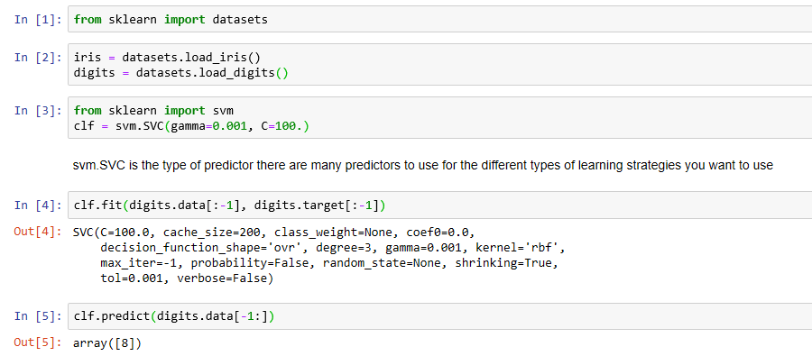
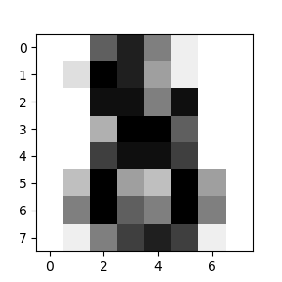
Scikit example

Slide 6
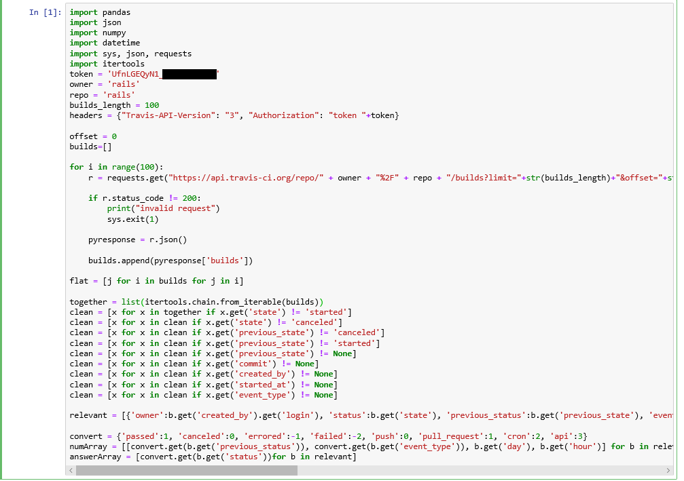
Cleaning and Data Gathering

Slide 7
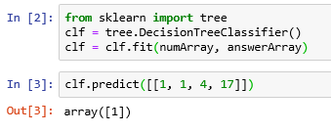
Decision Tree Prediction

Slide 8
TensorFlow
Open source library for numerical computation and machine learning built by Google
Bundles machine learning and neural networks(subset of machine learning)
The python front end is just an easy to use api that connects to a highly optimized C++ back end

Slide 9
TensorFlow Tutorial
Tutorial
https://www.tensorflow.org/tutorials/keras/basic_classification
Online Notebook
https://colab.research.google.com/github/tensorflow/docs/blob/r2.0rc/site/en/tutorials/keras/basic_classification.ipynb

